Slide 1


Version Control with Git

Slide 2
Motivation

Slide 3
Version Control Benefits
Keep track of changes made to files including deleted files
Work on separate versions of a file

Slide 4
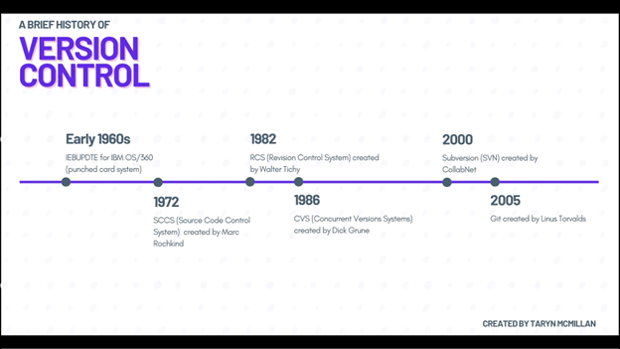
Brief History About Version Control
Before Git, there were other version control systems that were primitive relative to what Git is today.
Git was created in 2005 by Linus Torvalds, the creator of Linux, because he needed a tool better than SVN (or Subversion) which was
Reference: A History of Version Control (tarynmcmillan.com)

Slide 5
Benefits of Git vs Other VC Systems
Decentralized repositories
That's mostly it...

Slide 6
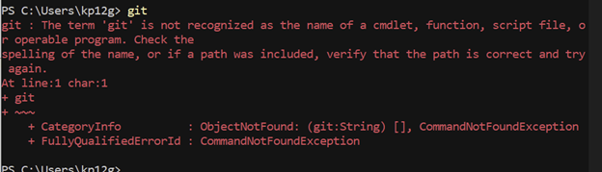
Installing Git on Windows
Git is not installed by default on Windows
Go here and download the 64-bit Git for windows setup: https://git-scm.com/download/win .
Run the executable and click NEXT button until Git is installed.

Slide 7
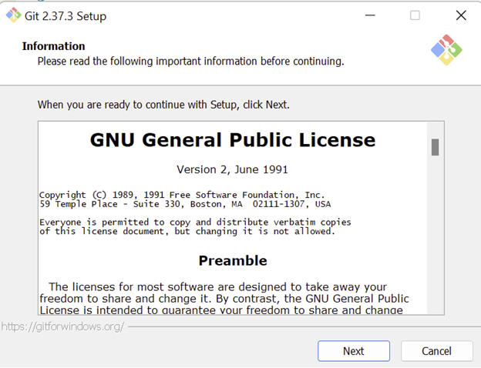
Installing Git on Linux
LINUX USERS can simply run: sudo apt install git.
Press NEXT button at all of the other menus of the installer window.

Slide 8
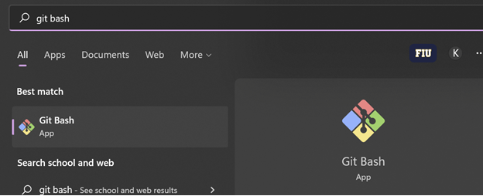
Post-installation
Search and open Git Bash
We'll be working in the Git Bash terminal here on out

Slide 9
Post-installation: Configuring Git Settings
Run these:
git config --global init.defaultbranch main
git config --global user.name "you name"
git config --global user.email "your email"
Confirm your settings by running git config --list

Slide 10
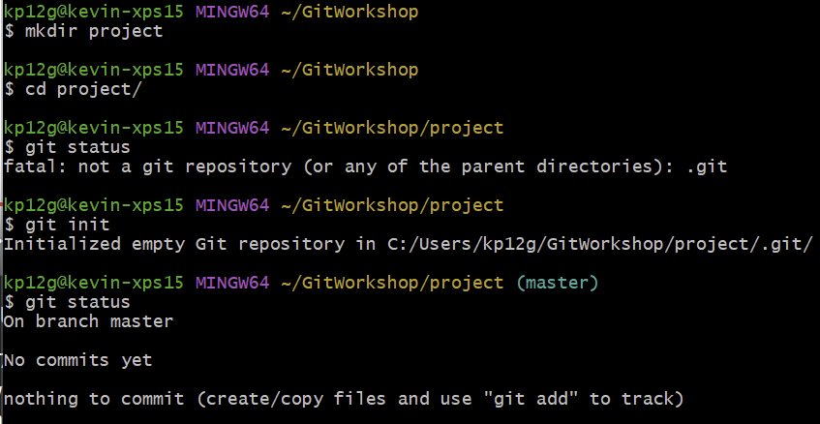
Make a Git repo
Create a directory (aka folder) anywhere on your computer. This will be the location of your project files.
Run the git init command to create a git repo.
You have now initialized your directory with a git repository for tracking changes. Run git status to check the status of the git repo.

Slide 11
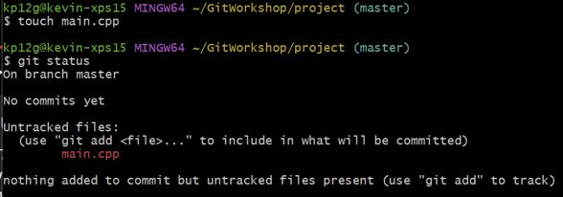
Create a File
Create a file in the terminal using the touch command. For example: touch main.cpp
If you run git status, you will notice the new file is not being tracked in the git repo. Untracked files are said to be in the working tree - this is where all added, deleted, or edited files are located.

Slide 12
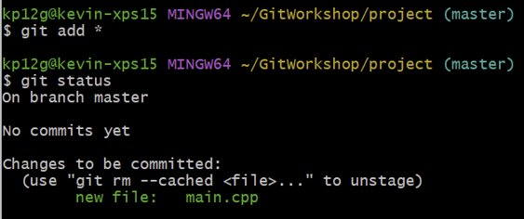
Make a Git to Track Your File
Run the git add <your file name>. git status will show changes have been detected. This means Git is now tracking the file.
Files with changes that are ready to be committed are index in the staging area - this is where all files from the working tree chosen to be included in the next commit are indexed.

Slide 13
Your First Commit
Run git commit -m "simple message describing your changes"
Your working tree is now clean because no changes since the previous commit have been detected.

Slide 14
A Note About Committing
It's good practice to commit new files as early as possible.
Keep your commit messages short yet descriptive of the changes.
Commit when your changes have been finalized. Commit often!

Slide 15
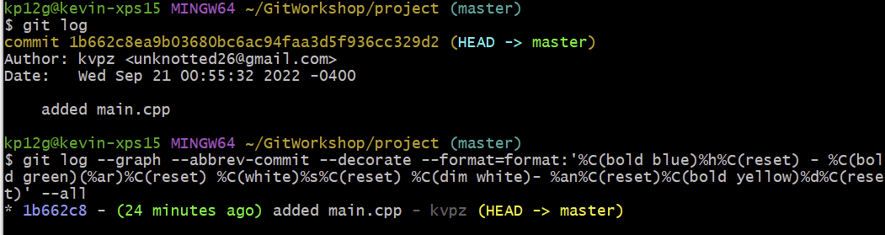
View Your Commit History
Run the git log command.
There are flags you can add to the git log command that reveal extra information and visualization of the git repo using ascii art.
Notice that commits are assigned a unique hash value.

Slide 16
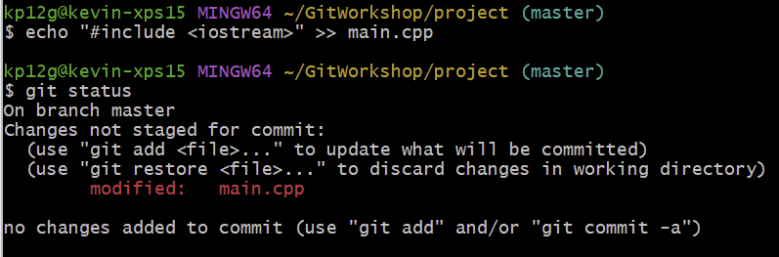
Modify a File in Your Project Directory
Add some text to the same file you recently committed then run git status.

Slide 17
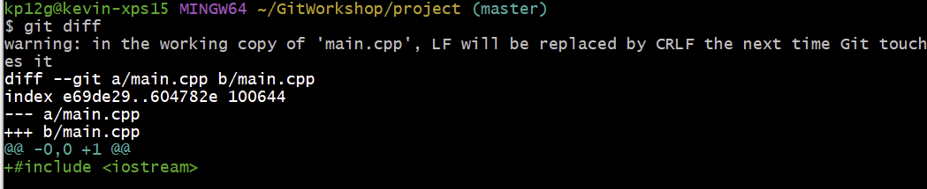
Observe Changes in Working Tree
Run the git diff command to see changes made in your file.
The git diff command without extra flags compares everything that is in the WORKING TREE and whatever else is being tracked.
Untracked files will not be compared. You can prove this to yourself by creating another file then running git diff again.

Slide 18
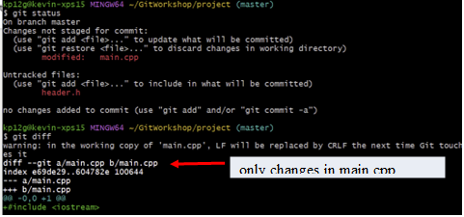
Exhibit: Git Diff Only Compares Tracked Files

Slide 19
Undo Changes in Files Using Previous Commits
Scenario: you made some changes to a file and you want to undo all of these changes. You undo the changes by replacing the file with the state of the file during the last commit. This can be accomplished by using git checkout -- <your file's name>.
Why this is helpful?
No need to go into the file and waste time undoing changes manually. Git keeps track of ALL changes including added whitespace!
If you use the Undo button in your text editor, you may undo changes from your latest commit(s).

Slide 20
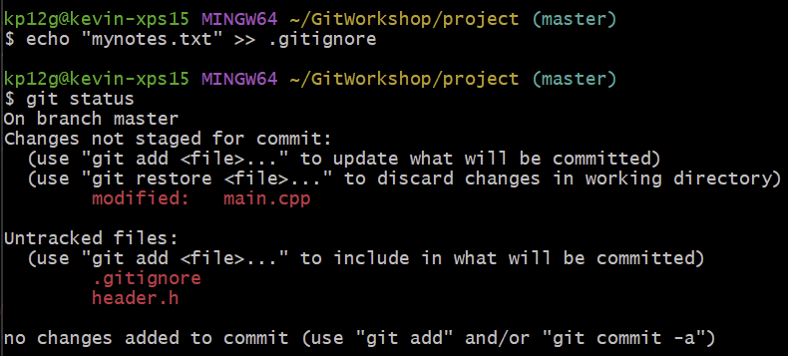
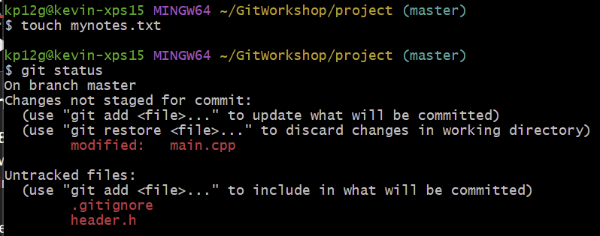
Prevent Files From Being Tracked
Files that should not be tracked can be listed in a file called .gitignore.
Scenario when you may want to do this: you created a file where you keep personal notes which are unrelated to the project itself.
Notice the "mynotes.txt" file is completely ignored by the Git repo because its name is in .gitignore.

Slide 21
Any Questions so far?

Slide 22

Branches
Provide a way to separate work.
Allows development on same files with different commit histories.
Useful for developing features that require lots of modifications.

Slide 23
Create Your Branches
Branching commands:
git branch -l will list all the branches in your working directory.
git branch dev creates a new branch named "dev" if it doesn't exist
git checkout dev moves the HEAD pointer to the "dev" branch.
HEAD pointer points to a commit on the current branch.
Go ahead and run the three commands above then run git status.
If you want to delete a branch, run git branch -d <branch name>

Slide 24
Combining Changes from Different Branches
git merge <branch name> - this command merges changes from the branch <branch name> into the current branch.
Issues can arise when the commit history of two branches differ.
An example of a merge of one branch into another without issues is a fast-forward merge.
A fast-forward merge occurs when the git merge <branch name> command is run from a branch when the last commit of current branch matches the first commit of <branch name>.
Commit history is copied from the merged branch.

Slide 25
Introducing Github
Create a Github account
Create a repository (name it whatever you want)
Follow the instructions on Github for pushing an existing repository from the command line
Click on the word "commits" at the top right of the Github repo

Slide 26
Git Remotes
Commands that deal with remote repositories:
git remote
git pull
git push
git fetch
git clone

Slide 27
Working with a Team

Slide 28
Start Collaborating!

